Slide 1
UNIT-4
Behavioural Modelling:
Interactions
Interaction diagrams
Use cases
Use case Diagrams
Activity Diagrams
Events and signals
state machines
processes and Threads
Time and space
state chart diagrams

Slide 2
UNIT-4
Architectural Modelling:
Component
Deployment
Component diagrams
Deployment diagrams

Slide 3
UNIT-4
Behavioural Modelling
Interactions:
In UML, the dynamic aspects of a system can be modelled using interactions. Interactions contain messages that are exchanged between objects. A message can be an invocation of an operation or a signal.
We can use interactions to model the flow of control within an operation.
Using interaction diagrams, we can model these flows in two ways: one is by focusing on how the messages are dispatched across time and the second is by focusing on the structural relationships between objects and then consider how the messages are passed between the objects.
interactive behaviour is represented in UML by two diagrams known as Sequence diagram and Collaboration diagram. The basic purpose of both the diagrams are similar.

Slide 4
Behavioural Modelling
Purpose of Interaction Diagrams:
The purpose of interaction diagrams is to visualize the interactive behaviour of the system. Visualizing the interaction is a difficult task. Hence, the solution is to use different types of models to capture the different aspects of the interaction.
The sequence diagram envisions the order of the flow of messages inside the system by depicting the communication between two lifelines, just like a time-ordered sequence of events.
The collaboration diagram, which is also known as the communication diagram, represents how lifelines connect within the system, whereas the timing diagram focuses on that instant when a message is passed from one element to the other.

Slide 5
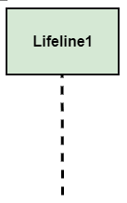
Behavioural Modelling
Notation of an Interaction Diagram
Purpose of an Interaction Diagram
To visualize the dynamic behaviour of the system.
To envision the interaction and the message flow in the system.
To portray the structural aspects of the entities within the system.
To represent the order of the sequenced interaction in the system.
To visualize the real-time data and represent the architecture of an object-oriented system.

Slide 6
Behavioural Modelling
Use of an Interaction Diagram
The sequence diagram is employed to investigate a new application.
The interaction diagram explores and compares the use of the collaboration diagram sequence diagram and the timing diagram.
The interaction diagram represents the interactive (dynamic) behavior of the system.
The sequence diagram portrays the order of control flow from one element to the other elements inside the system, whereas the collaboration diagrams are employed to get an overview of the object architecture of the system.
The interaction diagram models the system as a time-ordered sequence of a system.
The interaction diagram models the system as a time-ordered sequence of a system.
The interaction diagram systemizes the structure of the interactive elements

Slide 7
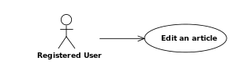
Behavioural Modelling
use cases :
A use case is a list of actions or event steps typically defining the interactions between a role (known in the Unified Modelling Language (UML) as an actor) and a system to achieve a goal.
The actor can be a human or other external system.
use cases are used at a higher level
Use cases are a technique for capturing, modelling and specifying the requirements of a system.
Below is a sample use case

Slide 8
Behavioural Modelling
Use Case Diagrams :
A use case diagram is used to represent the dynamic behavior of a system. It encapsulates the system's functionality by incorporating use cases, actors, and their relationships.
Purpose of Use Case Diagrams
It gathers the system's needs.
It depicts the external view of the system.
It recognizes the internal as well as external factors that influence the system.
It represents the interaction between the actors.

Slide 9
Behavioural Modelling
How to draw a Use Case diagram
It is essential to analyse the whole system before starting with drawing a use case diagram, and then the system's functionalities are found. And once every single functionality is identified, they are then transformed into the use cases to be used in the use case diagram.
Some rules that must be followed while drawing a use case diagram:
A pertinent and meaningful name should be assigned to the actor or a use case of a system.
The communication of an actor with a use case must be defined in an understandable way.
Specified notations to be used as and when required.
The most significant interactions should be represented among the multiple no of interactions between the use case and actors.

Slide 10
Example of Use case Diagram
A use case diagram depicting the Online Shopping website is given below.
Here the Web Customer actor makes use of any online shopping website to purchase online. The top-level uses are as follows; View Items, Make Purchase, Checkout, Client Register. The View Items use case is utilized by the customer who searches and view products. The Client Register use case allows the customer to register itself with the website for availing gift vouchers, coupons, or getting a private sale invitation. It is to be noted that the Checkout is an included use case, which is part of Making Purchase, and it is not available by itself.
The View Items is further extended by several use cases such as; Search Items, Browse Items, View Recommended Items, Add to Shopping Cart, Add to Wish list.

Slide 11
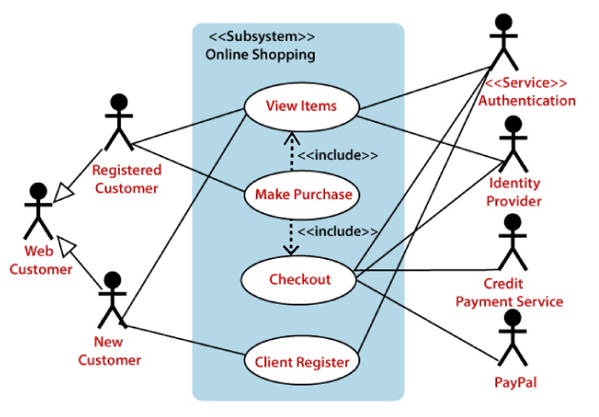
Example of Use case Diagram

Slide 12
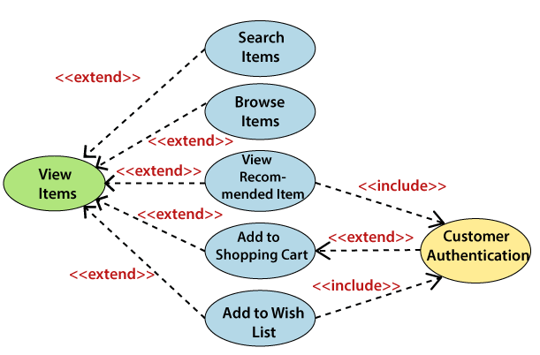
Example of Use case Diagram
Both View Recommended Item and Add to Wish List include the Customer Authentication use case, as they necessitate authenticated customers, and simultaneously item can be added to the shopping cart without any user authentication.

Slide 13
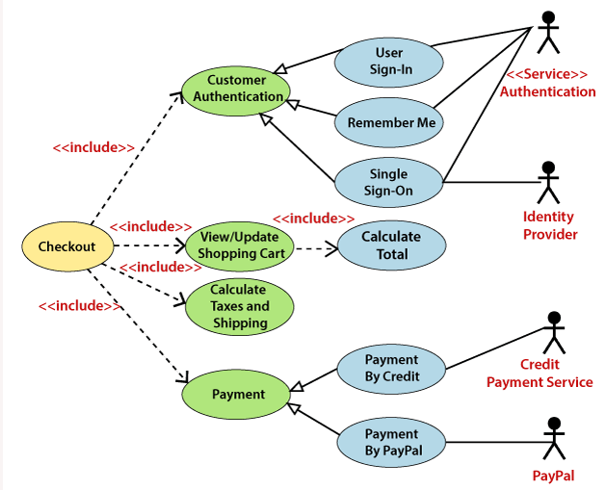
Example of Use case Diagram
The Checkout use case also includes the following use cases, as shown below. It requires an authenticated Web Customer, which can be done by login page, user authentication cookie ("Remember me"), or Single Sign-On (SSO). SSO needs an external identity provider's participation, while Web site authentication service is utilized in all these use cases..

Slide 14
Use Case Diagram
some important tips that are to be kept in mind while drawing a use case diagram:
A simple and complete use case diagram should be articulated.
A use case diagram should represent the most significant interaction among the multiple interactions.
At least one module of a system should be represented by the use case diagram.
If the use case diagram is large and more complex, then it should be drawn more generalized.

Slide 15

Activity Diagrams
The activity diagram is used to demonstrate the flow of control within the system rather than the implementation. It models the concurrent and sequential activities.
It is also termed as an object-oriented flowchart. It encompasses activities composed of a set of actions or operations that are applied to model the behavioural diagram.
Components of an Activity Diagram
Activities
The categorization of behaviour into one or more actions is termed as an activity.

Slide 16
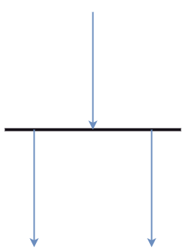
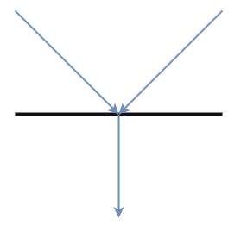
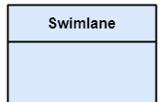
Activity Diagrams
Swim lane: The swim lane is used to cluster all the related activities in one column or one row. It can be either vertical or horizontal. It used to add modularity to the activity diagram.
Forks: Forks and join nodes generate the concurrent flow inside the activity. A fork node consists of one inward edge and several outward edges.
Join Nodes: Join nodes are the opposite of fork nodes. A Logical AND operation is performed on all of the inward edges as it synchronizes the flow of input across one single output (outward) edge.

Slide 17


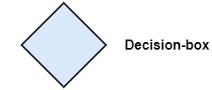

Activity Diagrams
Notation of an Activity diagram
Initial State: It depicts the initial stage or beginning of the set of actions.
Final State: It is the stage where all the control flows and object flows end.
Decision Box: It makes sure that the control flow or object flow will follow only one path.
Action Box: It represents the set of actions that are to be performed

Slide 18
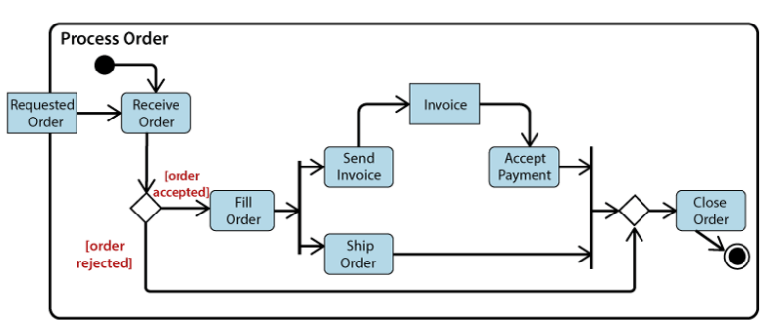
Activity Diagrams
Example of an Activity Diagram:
An activity diagram showing the business flow activity of order processing.

Slide 19
Activity Diagrams
An activity diagram can be used to portray business processes and workflows.
An activity diagram is utilized for the followings:
To graphically model the workflow in an easier and understandable way.
To model the execution flow among several activities.
To model comprehensive information of a function or an algorithm employed within the system.
To model the business process and its workflow.
To envision the dynamic aspect of a system.
To generate the top-level flowcharts for representing the workflow of an application.
To represent a high-level view of a distributed or an object-oriented system.

Slide 20
Events and Signals
Events and Signals
The different things that happen are called events
Many events occur at the same time and at unexpected times
Events represent important occurrences that have a time (the time when the event happened) and space (where the event happened)
Events are used to model stimulus that can make a state machine to change its state
Events can be of two types -synchronous or asynchronous
In a synchronous event the sender waits for an action from the receiver on the event. For example, pressing a button on the mouse, a phone call, etc.
There is no waiting in an asynchronous event. For example, sending an e-mail, letter, delivery of newspaper, etc.

Slide 21
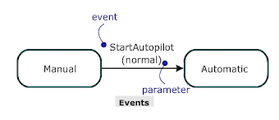
Events and Signals
Events
Signals
Signals refer to the objects that are dispatched asynchronously by one object and then received by another
Exceptions and e-mails are an example of internal signals
They may have instances, generalization relationships, attributes and operations
Attributes of a signal serve as its parameters

Slide 22
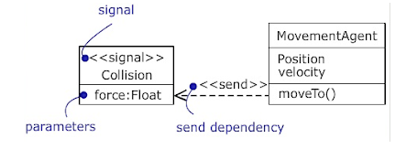
Events and Signals
It may be sent as the action of a state transition in a state machine or the sending of a message in an interaction
Signals are modelled as stereotyped classes and the relationship between an operation and the events by using a dependency relationship, stereotyped as send.

Slide 23
Events and Signals
Sending and Receiving Events
For Synchronous Events:
Sending or receiving is similar to call event
The sender and the receiver are in a meeting (the sender sends the signal and wait for a response from the receiver) for the duration of the operation
When an object calls an operation, the sender sends the operation and then waits for the receiver.
For Asynchronous Events:
Sending or receiving is similar to signal event
The sender and receiver do not meet, i.e., the sender sends the signal but does not wait for a response from the receiver
When an object sends a signal, the sender sends the signal and then continues along its flow of control, without waiting for any return from the receiver

Slide 24
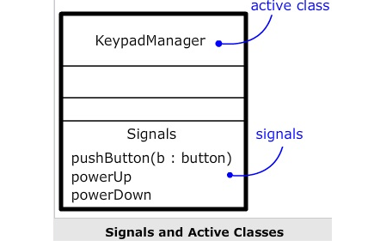
Events and Signals
Signals and Active Classes

Slide 25
State Machines
State machines :
The state machine diagram is also called the State chart or State Transition diagram, underwent by an object within the system which shows the order of states
It captures the software system's behaviour. It models the behaviour of a class, a subsystem, a package, and a complete system.
Following are the types of a state machine diagram
1. Behavioural state machine The behavioural state machine diagram records the behaviour of an object within the system. It depicts an implementation of a particular entity. It models the behaviour of the system.
2. Protocol state machine It captures the behaviour of the protocol. The protocol state machine depicts the change in the state of the protocol and parallel changes within the system. But it does not portray the implementation of a particular component.

Slide 26
State Machines
State machines :
Notation of a State Machine Diagram
Initial state: It defines the initial state (beginning) of a system, and it is represented by a black filled circle.
Final state: It represents the final state (end) of a system. It is denoted by a filled circle present within a circle.
Decision box: It is of diamond shape that represents the decisions to be made on the basis of an evaluated guard.
Transition: A change of control from one state to another due to the occurrence of some event is termed as a transition. It is represented by an arrow labelled with an event due to which the change has ensued.
State box: It depicts the conditions or circumstances of a particular object of a class at a specific point of time.
A rectangle with round corners is used to represent the state box.

Slide 27
State Machines
State machines :
Types of State
The UML consist of three states:
Simple state: It does not constitute any substructure.
Composite state: It consists of nested states (substates), such that it does not contain more than one initial state and one final state. It can be nested to any level.
Submachine state: The submachine state is semantically identical to the composite state, but it can be reused.

Slide 28
State Machines
Following are the steps that are to be incorporated while drawing a state machine diagram:
A unique and understandable name should be assigned to the state transition that describes the behaviour of the system.
Out of multiple objects, only the essential objects are implemented.
A proper name should be given to the events and the transitions.
State machine diagram is used for:
For modeling the object states of a system.
For modeling the reactive system as it consists of reactive objects.
For pinpointing the events responsible for state transitions.
For implementing forward and reverse engineering.

Slide 29
State Machines
Example of a State Machine Diagram
An example of a top-level state machine diagram showing Bank Automated Teller Machine (ATM) is given below.
Initially, the ATM is turned off. After the power supply is turned on, the ATM starts performing the start-up action and enters into the Self Test state. If the test fails, the ATM will enter into the Out Of Service state, or it will undergo a trigger less transition to the Idle state. This is the state where the customer waits for the interaction.
Whenever the customer inserts the bank or credit card in the ATM's card reader, the ATM state changes from Idle to Serving Customer, the entry action read Card is performed after entering into Serving Customer state. Since the customer can cancel the transaction at any instant, so the transition from Serving Customer state back to the Idle state could be triggered by cancel event.

Slide 30
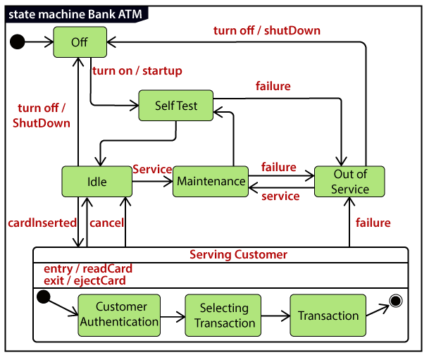
State Machines
Example of a State Machine Diagram

Slide 31
State Machines
Example of a State Machine Diagram
Here the Serving Customer is a composite state with sequential sub states that are Customer Authentication, Selecting Transaction, and Transaction.
Customer Authentication and Transaction are the composite states itself is displayed by a hidden decomposition indication icon. After the transaction is finished, the Serving Customer encompasses a trigger less transition back to the Idle state. On leaving the state, it undergoes the exit action eject Card that discharges the customer card.

Slide 32
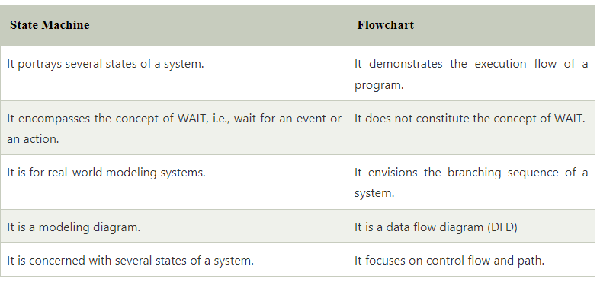
State Machines
State Machine Vs Flow Chart

Slide 33
Processes and Threads
Processes and Threads :
A process is a heavyweight flow that can execute concurrently with other processes. A process is an active program i.e. a program that is under execution. It is more than the program code as it includes the program counter, process stack, registers, program code etc. Compared to this, the program code is only the text section.
A process can create other processes to perform multiple tasks at a time; the created processes are known as clone or child process, and the main process is known as the parent process. Each process contains its own memory space and does not share it with the other processes. It is known as the active entity.
NEW: A new process is being created.
READY: A process is ready and waiting to be allocated to a processor.
RUNNING: The program is being executed.
WAITING: Waiting for some event to happen or occur.
TERMINATED: Execution finished.

Slide 34
Processes and Threads
Processes and Threads :
A thread is the subset of a process and is also known as the lightweight process. A process can have more than one thread, and these threads are managed independently by the scheduler. All the threads within one process are interrelated to each other. Threads have some common information, such as data segment, code segment, files, etc., that is shared to their peer threads. But contains its own registers, stack, and counter.

Slide 35
Processes and Threads
Processes and Threads :
Types of Threads
There are two types of threads, which are:
1. User Level Thread
As the name suggests, the user-level threads are only managed by users, and the kernel does not have its information.
These are faster, easy to create and manage.
2. Kernel-Level Thread
The kernel-level threads are handled by the Operating system and managed by its kernel. These threads are slower than user-level threads because context information is managed by the kernel. To create and implement a kernel-level thread, we need to make a system call.

Slide 36
Time and Space
Time and space PDF IS AVAILABLE.

Slide 37
Time and Space
Time and space PDF IS AVAILABLE.

